Slide 1
Building Resilient Web APIs with .NET Core 2.1
@neekgreen | Nicholas Myers
Notes:
Hello and good afternoon! I am Nicholas and I am excited to spend a few moments with you talking about Building Resilient Web APIs using .NET Core 2.1!

Slide 2
Nicholas Myers is a software artisan; he mixes code and creativity to produce software that simplifies complex business problems. Nicholas has over fourteen years experience building quality software in a variety of industries, including electronic publishing, travel management, and both residential and commercial real estate. He is a graduate of the University of South Alabama - *Go Jags*! He is passionate about .NET Core, open source software, and helping developers build better software. As a wannabe-nutritionist, Nicholas spends his downtime cooking, baking, and working out - usually in that order.
@neekgreen | Nicholas Myers
Notes:
A few things about me:

Slide 3

2+
@neekgreen | Nicholas Myers
Notes:
.

Slide 4
14+
@neekgreen | Nicholas Myers

Slide 5

7+
@neekgreen | Nicholas Myers

Slide 6

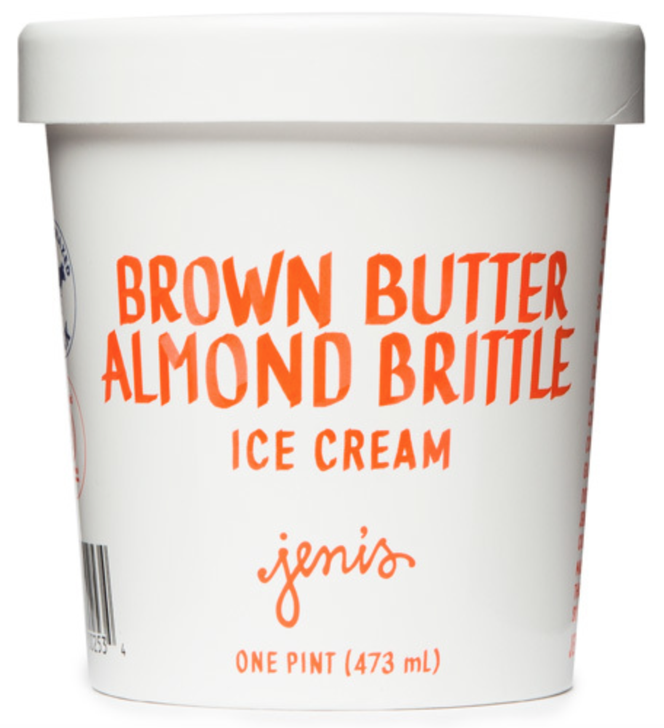
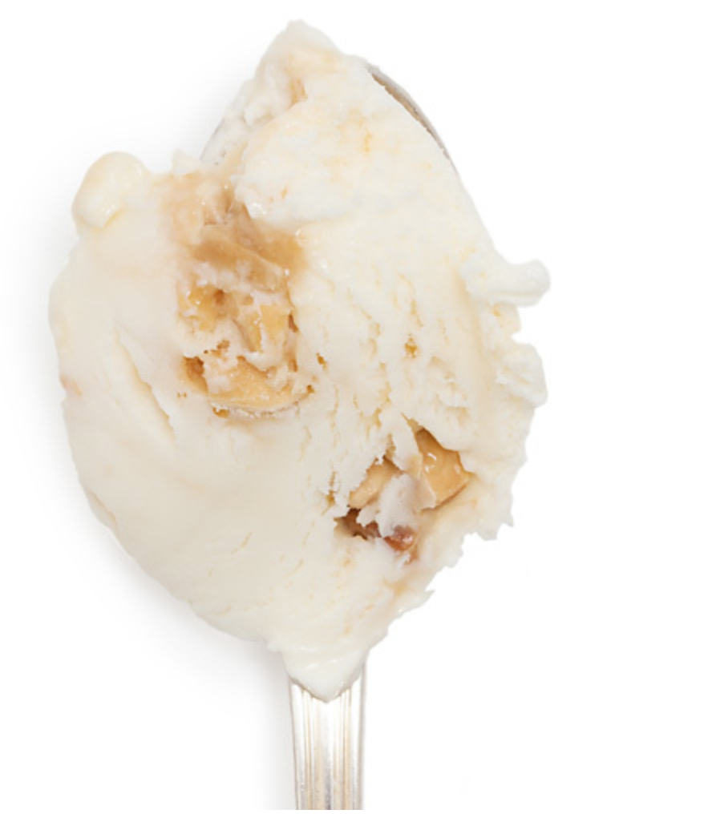
@neekgreen | Nicholas Myers

Slide 7
@neekgreen | Nicholas Myers

Slide 8
How do I run my applications in a scalable and fault tolerant manner?
https://medium.com/microhq/building-resilient-and-fault-tolerant-applications-with-micro-53b454a8e8eb
Notes:
I want to highlight some statements I read in an article about resilient software.
A lot of companies are now helping with the question of, “how do I run my applications in a scalable and fault tolerant manner?”, but there’s still very few helping with the more important question…

Slide 9
How do I actually write applications in a scalable and fault tolerant manner?
https://medium.com/microhq/building-resilient-and-fault-tolerant-applications-with-micro-53b454a8e8eb
Notes:
How do I actually write applications in a scalable and fault tolerant manner?
This is the target for today’s session.

Slide 10
Overview
Resiliency 101
Strategies for Building Resilience
.NET Core 2.1 Resiliency Features
Notes:
This is the outline for the evening. We will discuss resiliency - what it is, and why we should care. From there, we will review a number of strategies/patterns used to build resilient software. Finally, we will look at how we can leverage those strategies / patterns to bake reliance into our .NET Core 2.1 applications.

Slide 11
Resiliency 101
Strategies for Building Resilience
.NET Core 2.1 Resiliency Features
Notes:
Resiliency.
Lets get started.

Slide 12
How would you define resiliency?
Notes:
How would you define resiliency?

Slide 13
Resiliency is the capacity to recover quickly from difficulties, toughness.
Notes:
The Wikipedia definition of resiliency is the capacity to recover quickly from difficulties. Similar words include fault-tolerant, elasticity, toughness, malleable, and adaptable.

Slide 14
The goal of resiliency is to return the application to a fully functioning state after a failure.
Notes:
[Read Slide]
I am a big DC Marvel fan. I think a superhero is a great personification of resiliency.

Slide 15
Notes:
This is Green Arrow, aka Oliver Queen. He shows toughness and resourcefulness. Plus, he is a and a bow and arrow expert. Every hero needs a villain, and for Green Arrow, the villain is Slade Wilson aka Deathstroke.

Slide 16
Notes:
Deathstroke is the apitomy of a superhero’s villain. He can fight, use a sword and a gun, sometimes all in the same scene!

Slide 17
Notes:
What is interesting about Oliver and Slade, is that they used to be friends. There was this thing #spoilers, and Oliver realized he could not trust Slade any more.
Resiliency, is like a superhero too. Our applications aspire to be resilient – they want to be fault-tolerant. So, if resiliency is the hero, who or what would be it’s nemesis?

Slide 18
Notes:
The network.
The network is ultimately the greatest enemy to resilient software.

Slide 19


External
API #1
API
External
API #2
Notes:
Case study.
It is a misconception, a fallacy, for us to build web apps and always assume our external resources will be available 24/7/365.

Slide 20
External
API #1
API
External
API #2
Notes:
Case study.

Slide 21
A fallacy is a mistaken belief, especially one based on unsound argument.
Notes:
It is a fallacy. A fallacy is a mistaken belief, especially one based on unsound argument. What is the fallacy - what is the unsound argument?

Slide 22
The network is reliable.
Notes:
The fallacy is that the network is reliable.

Slide 23
Fallacies of distributed computing
Peter Deutsch and James Gosling
The network is reliable
Topology doesn't change
Latency is zero
There is one administrator
Bandwidth is infinite
Transport cost is zero
The network is secure
The network is homogeneous
Notes:
In the mid to late 90s, Peter and James (not that Peter and James) came up with the Eight Fallacies of Distributed Computing. The very first one is the network is reliable.

Slide 24
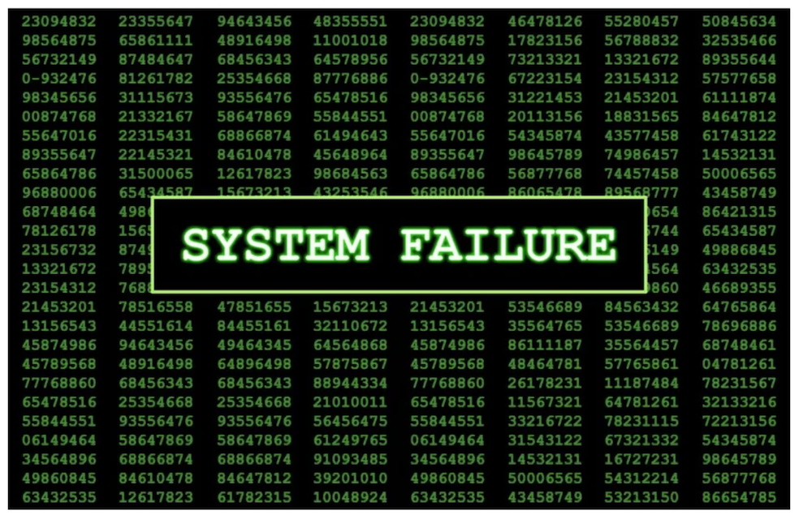
The network is not reliable.
Notes:
In reality, the network is not reliable.

Slide 25
Should our applications have trust issues with network reliability?
Notes:
Should our applications have trust issues with network reliability?

Slide 26
It is not about avoiding failures but accepting the fact that failures will happen.
Notes:
It is not about avoiding failures, but accepting the fact that failures will happen. When you accept that, you are able to plan for those failures.

Slide 27
Planning for Failure
Client
Server
Initial connection could fail as the client tries to connect to server.
Call could fail midway while server is fulfilling the operation, leaving the result in limbo.
Call could succeed, but connection breaks before the server can notify client.

Slide 28
Failure is a thing.
Notes:
Failure is a thing, especially in distributed computing. The type of failures we want to deal with in this session are transient errors.

Slide 29
A transient error (fault) is a temporary error that is likely to disappear soon.
Notes:
A transient error is the most common form of network failure. It is an error that is likely to disappear soon.
Transient faults are errors whose cause is expected to be a temporary condition such as temporary service unavailability or network connectivity issues.
At work, I joined a new team, and as you expect, you get access to the team’s artifacts – things such as source code, monitoring tools, error logs, etc. Our core system is configured to notify the team when it experiences any error. I was told day one to look at those exceptions, and if they were related to the network, I could ignore them. Why? They were transient errors – eventually, the errors will be corrected and the application would run as expected.
It would be really nice if the application knew that an error was transient in nature, and would not notify me. We will look how to do that in the next section.

Slide 30
Would you describe your web application backend as being resilient or fragile?

Slide 31
External
API #1
API
External
API #2
Notes:
Case study.

Slide 32
External
API #1
API
External
API #2
Notes:
Case study.

Slide 33
Resiliency 101
Strategies for Building Resilience
.NET Core 2.1 Resiliency Features

Slide 34
Transient faults are errors whose cause is expected to be a temporary condition such as temporary service unavailability or network connectivity issues.

Slide 35
Resiliency and Fault Tolerant Strategies
Reactive
Proactive

Slide 36
Retry Strategy
Make Request
Yes
Retry?
No
OK?
No
Return Response

Slide 37
Wait and Retry Strategy
Wait
Make Request
Yes
Retry?
No
OK?
No
Return Response

Slide 38
Timeout Strategy
Make Request
Yes
Slow?
Fail
No
Return Response

Slide 39
Circuit Breaker Strategy
Make Request
Return Response

Slide 40
Fallback Strategy
Make Request
No
OK?
Return Custom Response
Yes
Return Response

Slide 42
Resiliency 101
Strategies for Building Resilience
.NET Core 2.1 Resiliency Features

Slide 43
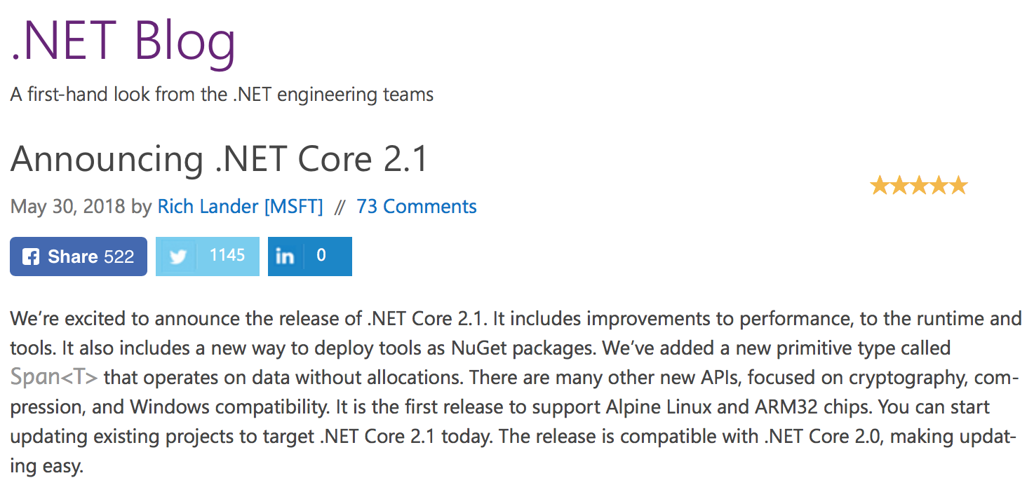
https://blogs.msdn.microsoft.com/dotnet/2018/05/30/announcing-net-core-2-1/

Slide 44
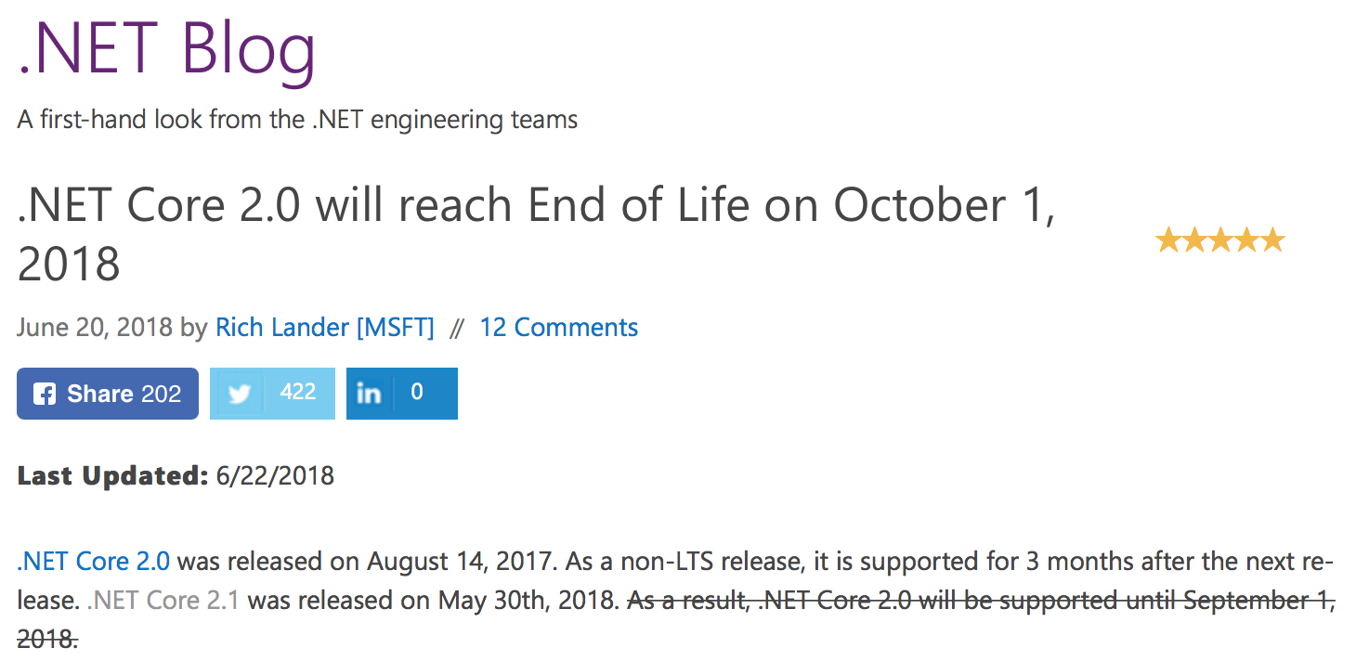
https://blogs.msdn.microsoft.com/dotnet/2018/06/20/net-core-2-0-will-reach-end-of-life-on-september-1-2018/

Slide 46
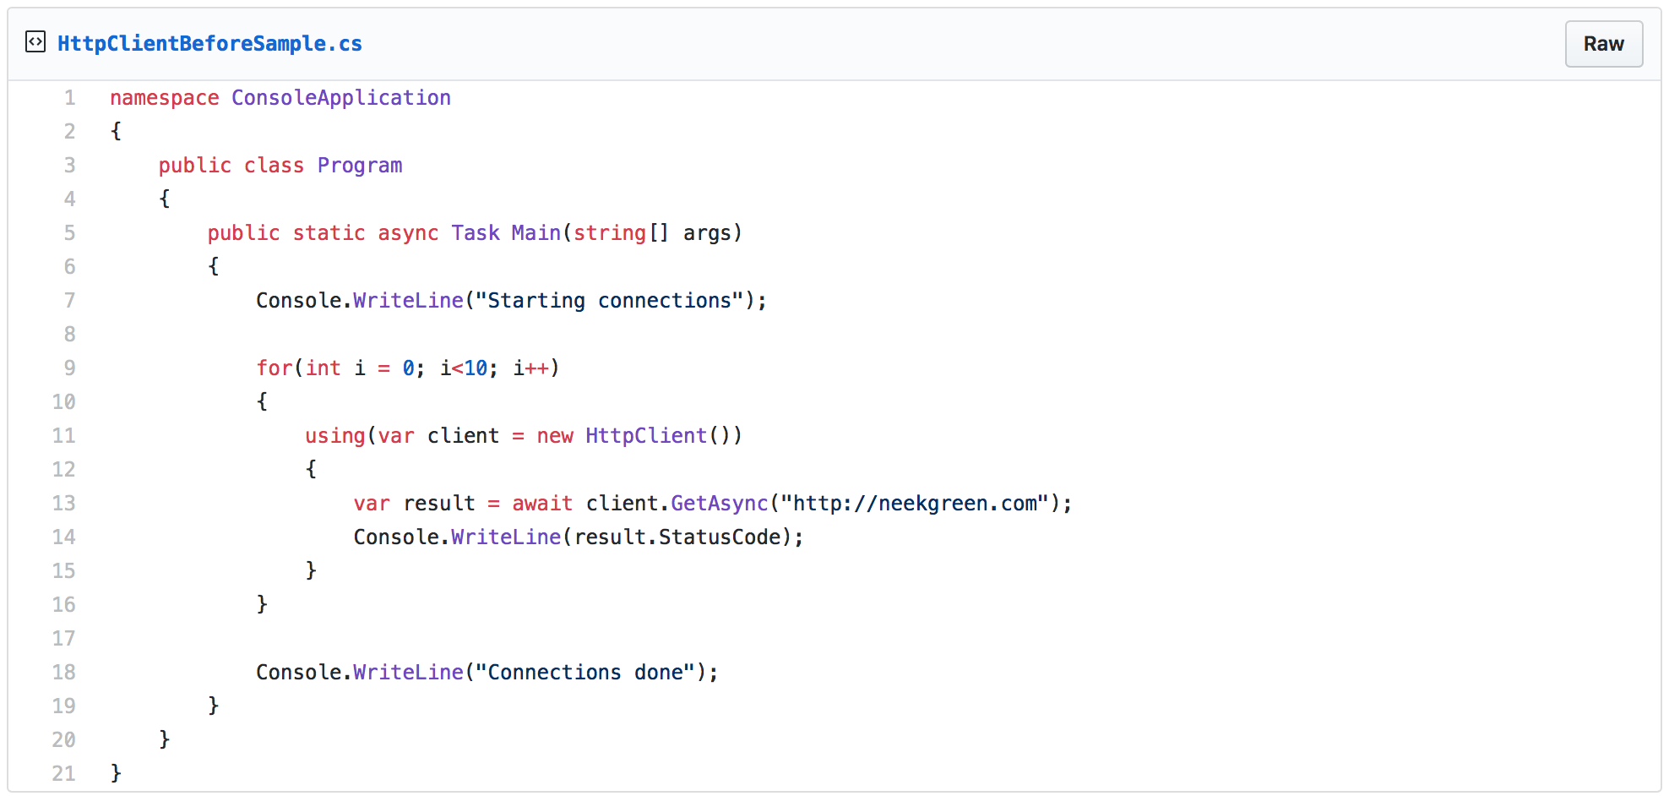

Slide 47
C:\code\testapp>dotnet run Compiling testapp for .NETCoreApp,Version=v2.1 Compilation succeeded. 0 Warning(s) 0 Error(s) Time elapsed 00:00:01.2501667 Starting connections OK OK OK OK OK OK OK OK OK OK Connections done
https://aspnetmonsters.com/2016/08/2016-08-27-httpclientwrong/

Slide 48
C:\code\socket>NETSTAT.EXE
...
Proto Local Address Foreign Address State
TCP 10.211.55.6:12050 waws-prod-bay-017:http TIME_WAIT
TCP 10.211.55.6:12051 waws-prod-bay-017:http TIME_WAIT
TCP 10.211.55.6:12053 waws-prod-bay-017:http TIME_WAIT
TCP 10.211.55.6:12054 waws-prod-bay-017:http TIME_WAIT
TCP 10.211.55.6:12055 waws-prod-bay-017:http TIME_WAIT
TCP 10.211.55.6:12056 waws-prod-bay-017:http TIME_WAIT
TCP 10.211.55.6:12057 waws-prod-bay-017:http TIME_WAIT
TCP 10.211.55.6:12058 waws-prod-bay-017:http TIME_WAIT
TCP 10.211.55.6:12059 waws-prod-bay-017:http TIME_WAIT
TCP 10.211.55.6:12060 waws-prod-bay-017:http TIME_WAIT
TCP 10.211.55.6:12061 waws-prod-bay-017:http TIME_WAIT
TCP 10.211.55.6:12062 waws-prod-bay-017:http TIME_WAIT
...
https://aspnetmonsters.com/2016/08/2016-08-27-httpclientwrong/

Slide 49
Unable to connect to the remote server System.Net.Sockets.SocketException: Only one usage of each socket address (protocol/network address/port) is normally permitted.
https://aspnetmonsters.com/2016/08/2016-08-27-httpclientwrong/

Slide 50
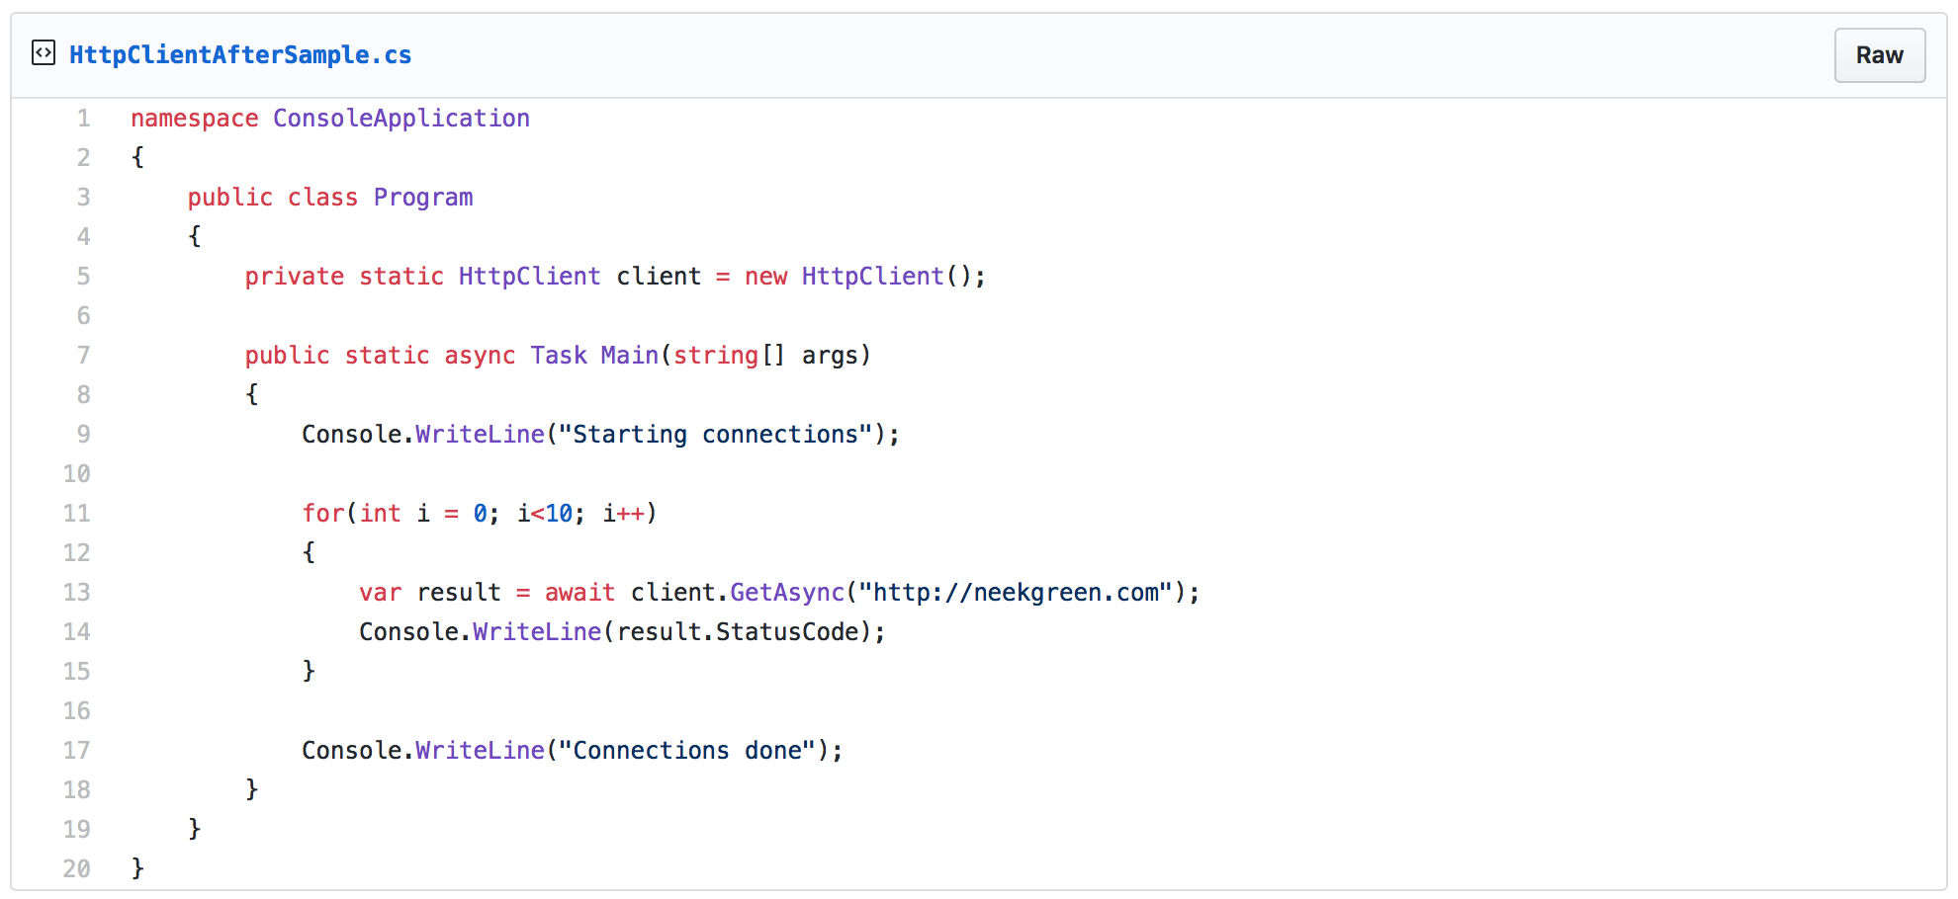

Slide 51
C:\code\testapp>dotnet run Compiling testapp for .NETCoreApp,Version=v2.1 Compilation succeeded. 0 Warning(s) 0 Error(s) Time elapsed 00:00:01.2501667 Starting connections OK OK OK OK OK OK OK OK OK OK Connections done
https://aspnetmonsters.com/2016/08/2016-08-27-httpclientwrong/

Slide 52
C:\code\socket>NETSTAT.EXE
...
Proto Local Address Foreign Address State
TCP 10.211.55.6:12050 waws-prod-bay-017:http TIME_WAIT
...
https://aspnetmonsters.com/2016/08/2016-08-27-httpclientwrong/

Slide 53
https://aspnetmonsters.com/2016/08/2016-08-27-httpclientwrong/

Slide 54
HttpClient is very important in building resilient applications in .NET Core 2.1.

Slide 55
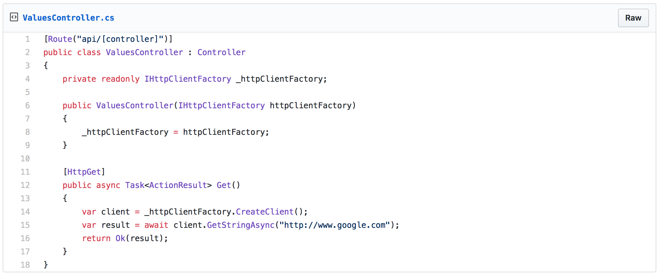
https://www.stevejgordon.co.uk/introduction-to-httpclientfactory-aspnetcore

Slide 56
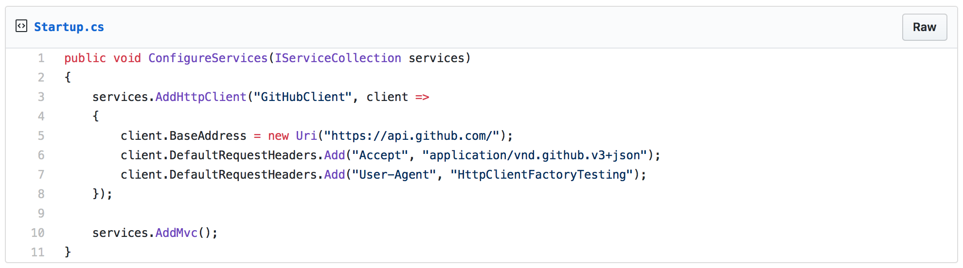
https://www.stevejgordon.co.uk/introduction-to-httpclientfactory-aspnetcore
Notes:
In this example, we are registering a HttpClient instance with a name.

Slide 57
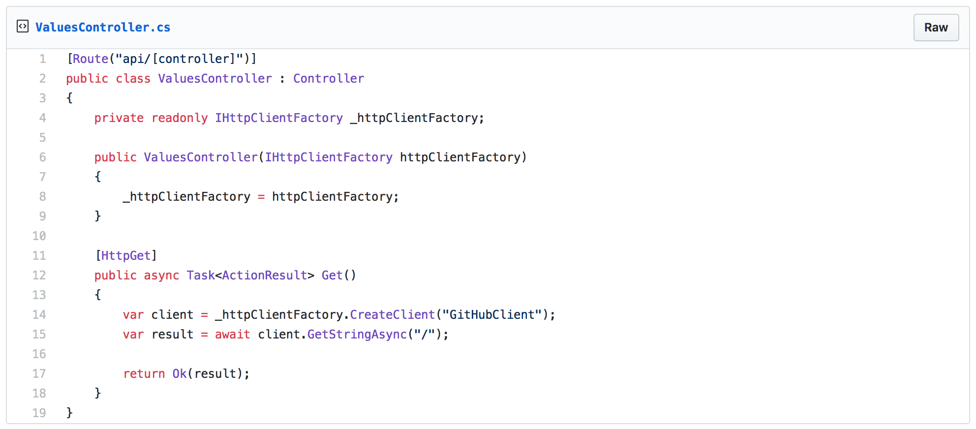
https://www.stevejgordon.co.uk/httpclientfactory-named-typed-clients-aspnetcore
Notes:
In the controller, we are using the new IHttpClientFactory interface to resolve that HttpClient. HttpClientFactory is Microsoft’s new way to manage HttpClient instances. Going forward, developers are no longer concerned about how to manage HttpClient instances.

Slide 58
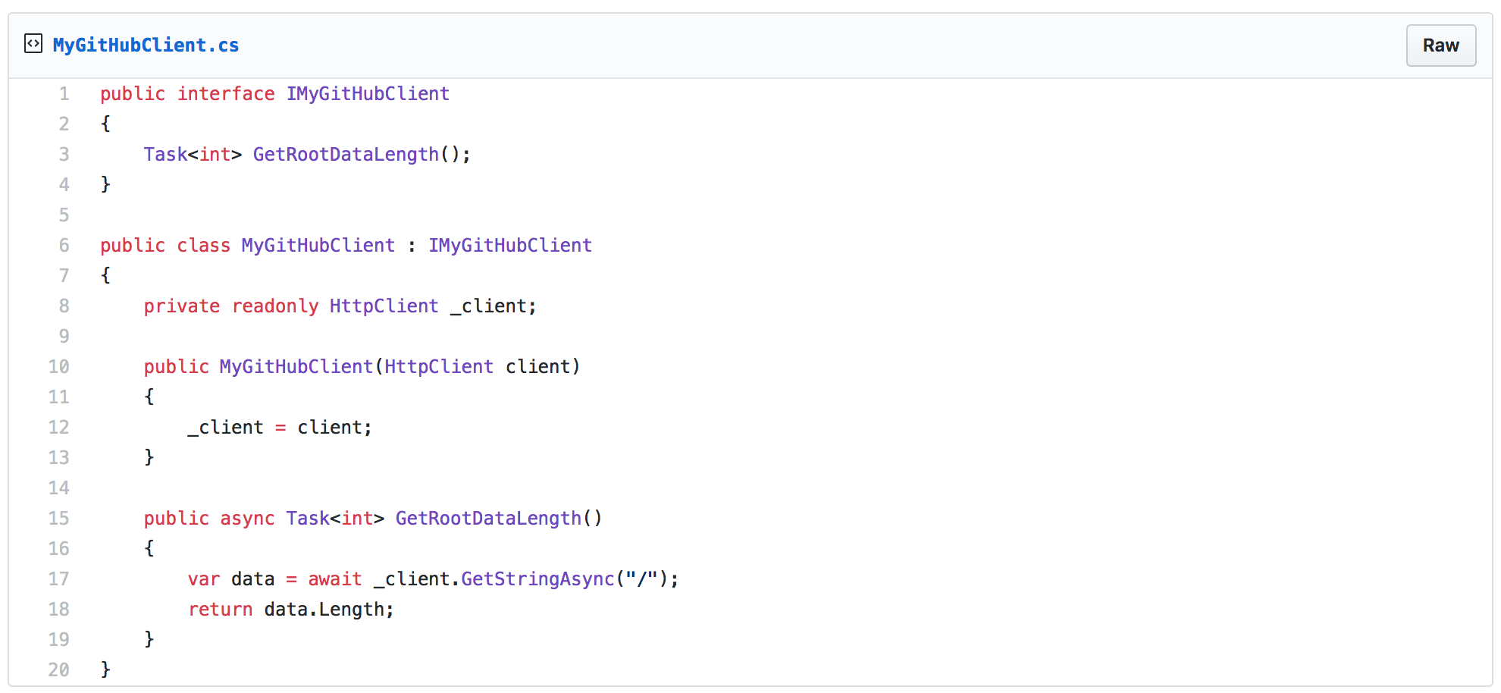
https://www.stevejgordon.co.uk/httpclientfactory-named-typed-clients-aspnetcore
Notes:
I like to encapsulate HttpClient instances using an interface and a concrete implementation.

Slide 59
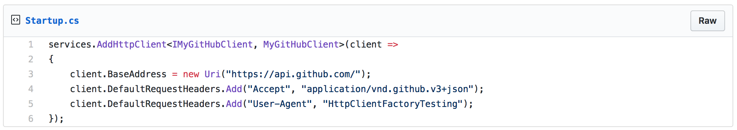
https://www.stevejgordon.co.uk/httpclientfactory-named-typed-clients-aspnetcore
Notes:
This is called TypedClients. We are registering an HttpClient instance, but instead of associated it with a string, we are associating it with an actual type, in this case, IMyGitHubClient.

Slide 60
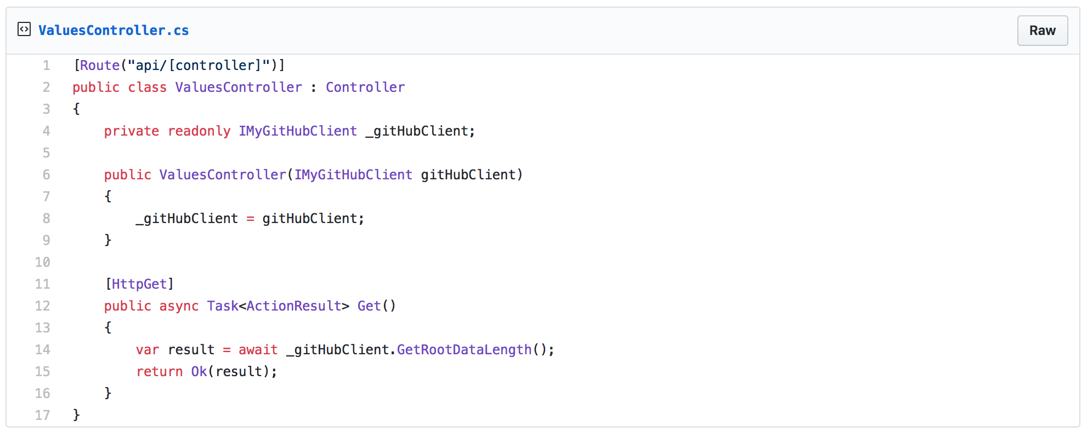
https://www.stevejgordon.co.uk/httpclientfactory-named-typed-clients-aspnetcore
Notes:
The controller uses DI to resolve the interface to the concrete implementation, and everything works as expected.

Slide 61
New HttpClient support is awesome, but what about building resiliency in our applications?
Notes:
To implement resiliency strategies we discussed earlier, we are going to leverage an open source project named Polly.

Slide 62
Notes:
Anyone remember this?
Enterprise Library is a library of Application Blocks designed to assist developers with common enterprise development challenges. These were big before open source, at least on the Microsoft scene, was a big deal. This is a remnant of the old Microsoft. The new Microsoft embraces the open source community.

Slide 63
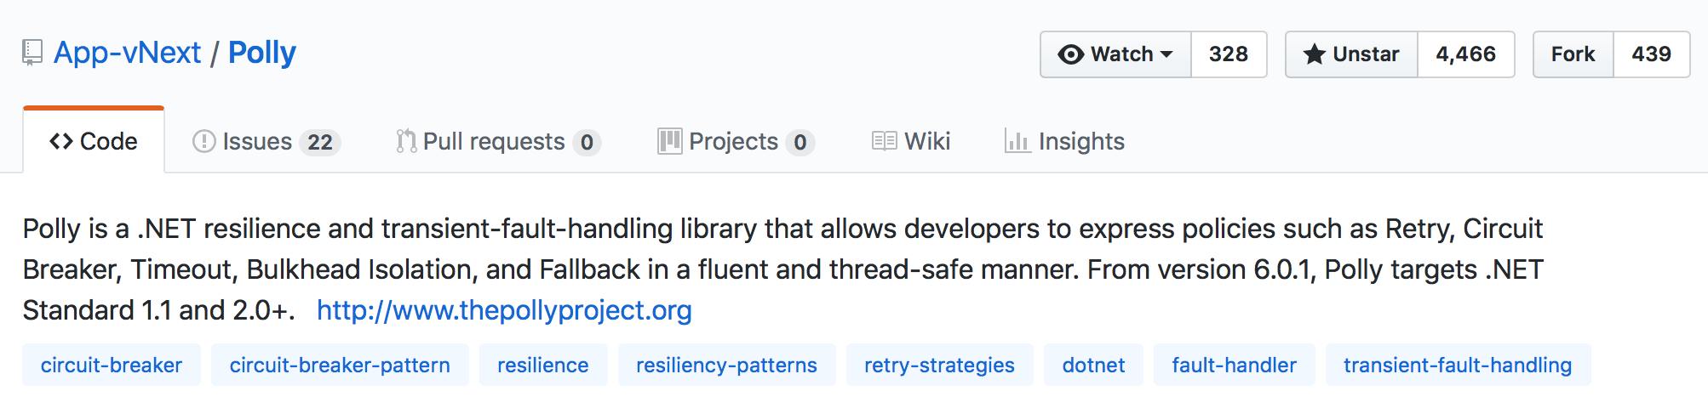
Notes:
Polly is a .NET resilience and transient-fault handling library that allows us to write resiliency policies in a fluent and thread-safe manner. Polly was created in 2013, and to date, has over 4M downloads. .NET Core 2.1 has built-in support for Polly.

Slide 64
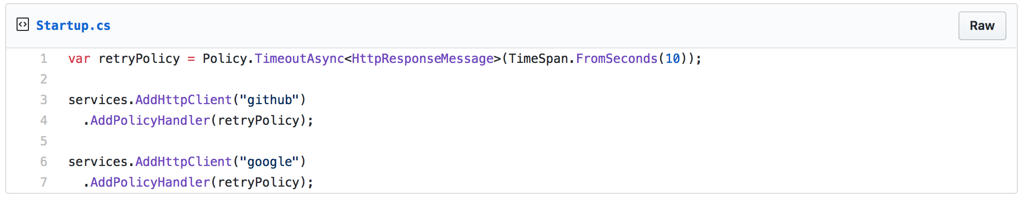
https://www.stevejgordon.co.uk/httpclientfactory-using-polly-for-transient-fault-handling

Slide 65
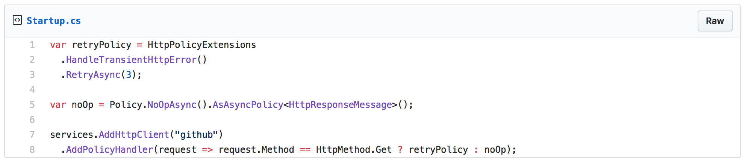
https://www.stevejgordon.co.uk/httpclientfactory-using-polly-for-transient-fault-handling

Slide 66
https://www.stevejgordon.co.uk/httpclientfactory-using-polly-for-transient-fault-handling

Slide 67
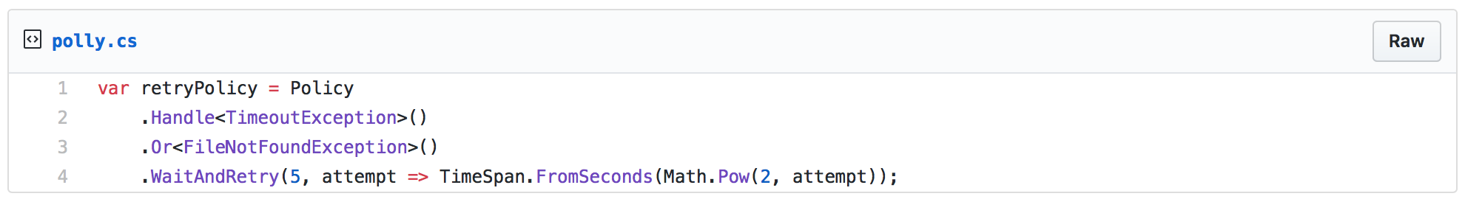
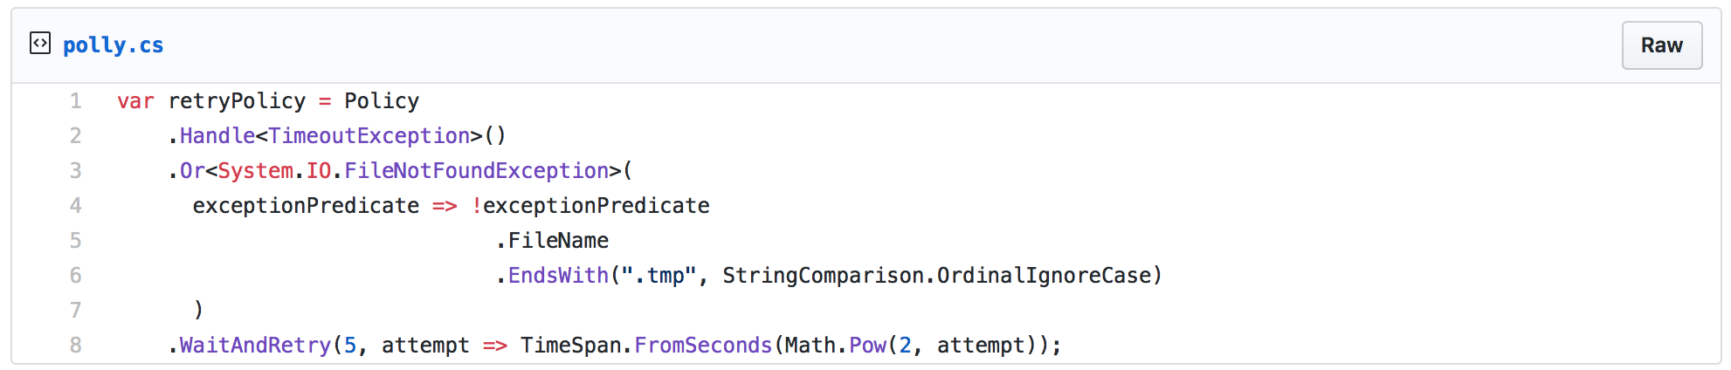
https://hackernoon.com/azure-sql-transient-errors-7625ad6e0a06

Slide 68
There is more to Polly than just providing HttpClient support.
Notes:
There is more to Polly than just working with HttpClient instances.

Slide 69
https://hackernoon.com/azure-sql-transient-errors-7625ad6e0a06
Notes:
Here is a policy that works with reading the contents of a file.

Slide 70
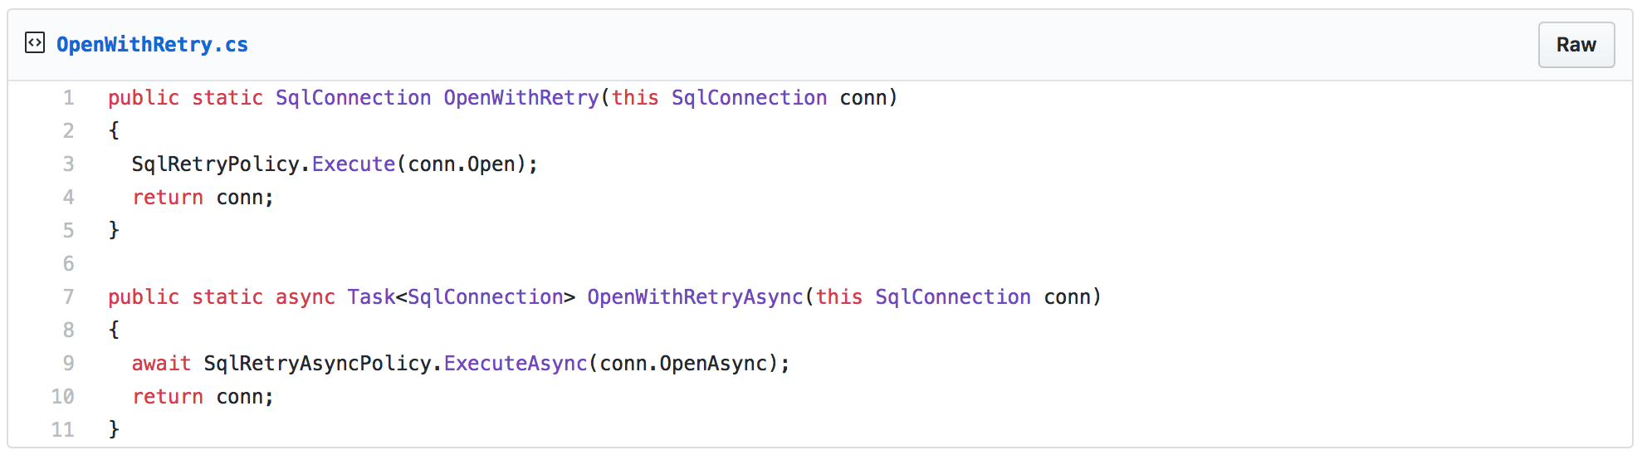
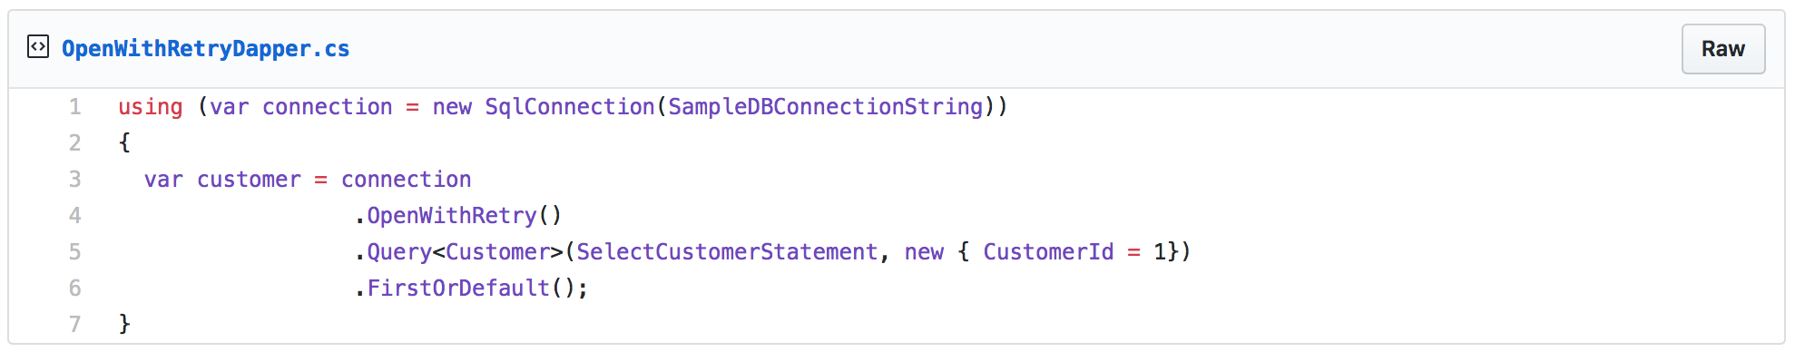
Notes:
Here is policy aimed at working with database related transient errors.

Slide 71
External
API #1
API
External
API #2
Notes:
Case study.

Slide 73
Polly
A .NET resilience and transient-fault-handling library
https://github.com/App-vNext/Polly
Refit
The automatic type-safe REST library for Xamarin and .NET
https://github.com/reactiveui/refit

